Slide 1

Homelessness Initiatives
Vanessa Matheny, Village of Oak Park
February 4, 2026
Notes:
Good afternoon, my name is Vanessa Matheny and I am the Community Services Administrator for the Village of Oak Park. I oversee the Community Services Division that supports Grants like CDBG, ARPA, and General Revenue, in addition to our E.C.H.O. program, and response to addressing homelessness in the community.

Slide 2




Agenda
Homelessness in Oak Park
E.C.H.O.
Interim Housing & Emergency Sheter
Funding Strategies
Notes:
During today’s presentation, I’d like to cover the following topics which we view as a comprehensive approach to support the unhoused population and all of their needs.

Slide 3
Homelessness in Oak Park
Notes:
According to the Office to Prevent and End Homelessness, which was established and Codified by our Governor in 2021; it is currently estimated that it takes 2.2 years for an individual to be identified as unhoused and be permanently placed in housing.
In 2025, our partner agency supported 119 individuals, 88 households (married couple), and 10 families with minors through street outreach for a total of 217
Since 2019 the organization has served 687 individuals, 532 households, and 46 families with minors = 1265 individuals
685 of those individuals were identified through street outreach

Slide 4
Village of Oak Park & E.C.H.O.
Weekly Cleanings & Engagement
Warming/ Cooling Center Operations
Public Health Nurse Screenings
Emergency Shelter Screenings
Care Coordination & Barrier Reduction
Flexible Rental Assistance Program
Sojourner House
Write Inn
Crisis Housing & Rental Support
Notes:
In January 2025, the Village of Oak Park implemented the E.C.H.O. program, Engaging Community for Healthy Outcomes. This program hired two care coordinators and one program manager, which is designed to enhance community safety, offer a non-emergency response, and reimagine public safety. The team also serves as the subject matter expert to addressing homelessness.
In the last year, E.C.H.O. spent 53% of their time to support our unhoused population. That includes weekly/daily engagement to build rapport and trust to enter into the shelter which includes time for our public health nurse to complete basic health screenings with wound care, diabetes test, or supply narcan, activation of warming and cooling centers, weekly cleanings to prevent/reduce encampments to balance public health and safety with the homelessness bill of rights, supports the access to the emergency shelter which requires a screening through the call center or the street outreach provider while also updating the “by-name list” which gives us an opportunity to identify everyone by name, share where they were last seen if one of our known “hot spots” or elsewhere in the community, and what services they may need if it is in addition to shelter or if they have changed their mind to access shelter. In addition, they work to identify other barriers/needs that the individual may have, whether that is access to med management, transportation, entitlement benefits, food, etc. and work to reduce the barriers, while building trust, and work to get an individuals housed that are identified in the community.
The Village of Oak Park funds other programs through our Affordable Housing Trust fund, which includes:
Flexible rental assistance program – working to prevent homelessness which will pay rent, utilities, etc to keep people housed
Sojourner Housing – temporary housing for families with minor children, persons with physical limitations who need respite after hospital discharge
Write Inn – 65 beds for interim housing, individuals and families experiencing homelessness with short-term private accommodations combined with programming, like wraparound services, case management, and income supports. Location also includes the RISE center which partners with the local hospital, 19 medical respite beds for medical and behavioral health access
CHRS – Designed to serve transition-aged youth and families, families fleeing domestic violence, provides temporary housing for the population through temporary rental assistance, provides case management, family advocacy, housing navigation, and wraparound services

Slide 5
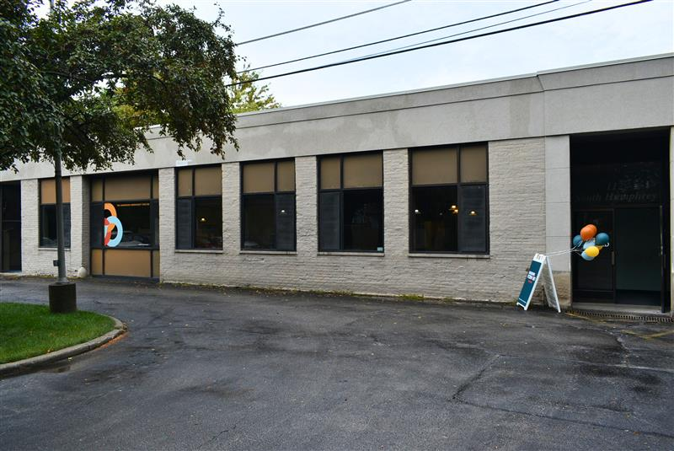
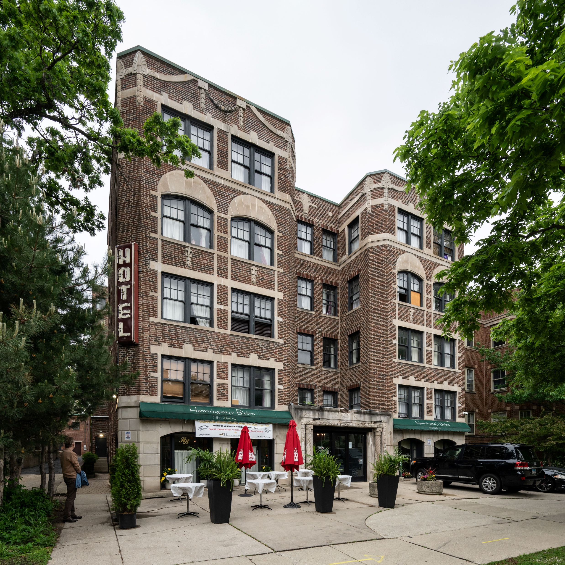
Interim Housing & Emergency Shelter
Anderson Emergency Shelter
Write Inn – Interim Housing
Notes:
Anderson Emergency Shelter
4,500 Sq. ft facility owned by Oak Park Housing Authority
5 bathrooms, 2 showers, 1 congregate dining area, 3 semi-private sleeping areas, 2 offices, 1 commercial kitchen
Near CTA Green Line – Austin, CTA and PACE Bus routes
Operates 365 days per year 5:00 p.m. – 9:00 a.m.

Slide 6
Funding Strategies
Village of Oak Park General Revenue
Cook County
State of Illinois (DCEO)
ARPA

Slide 7
Discussion

